Slide 1
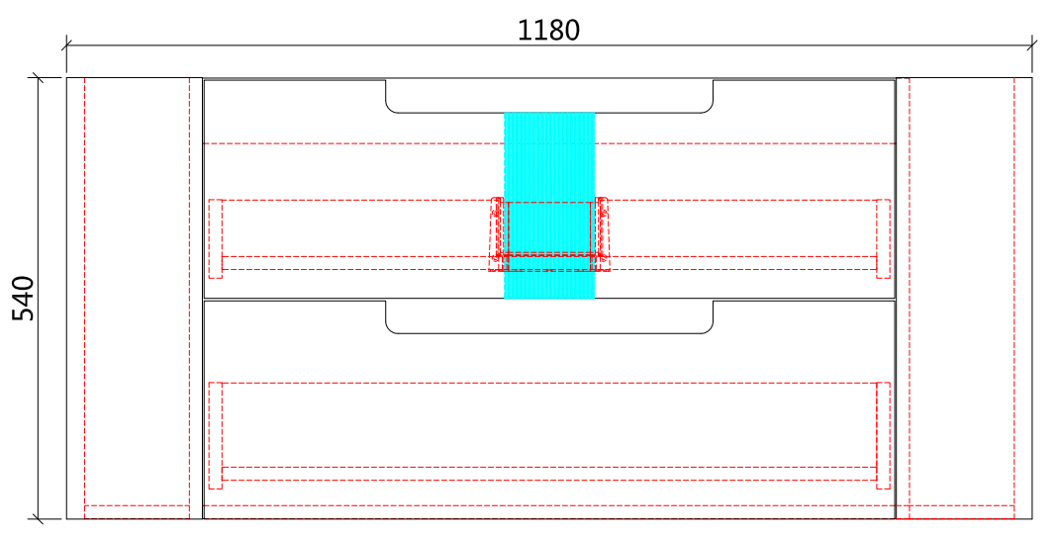
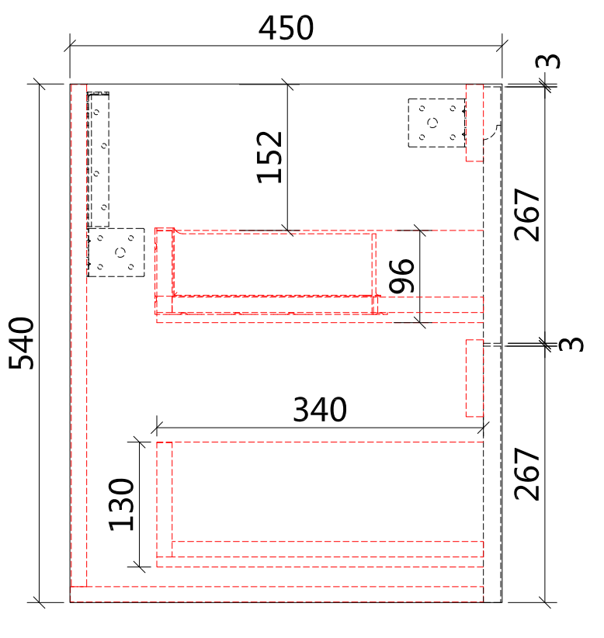
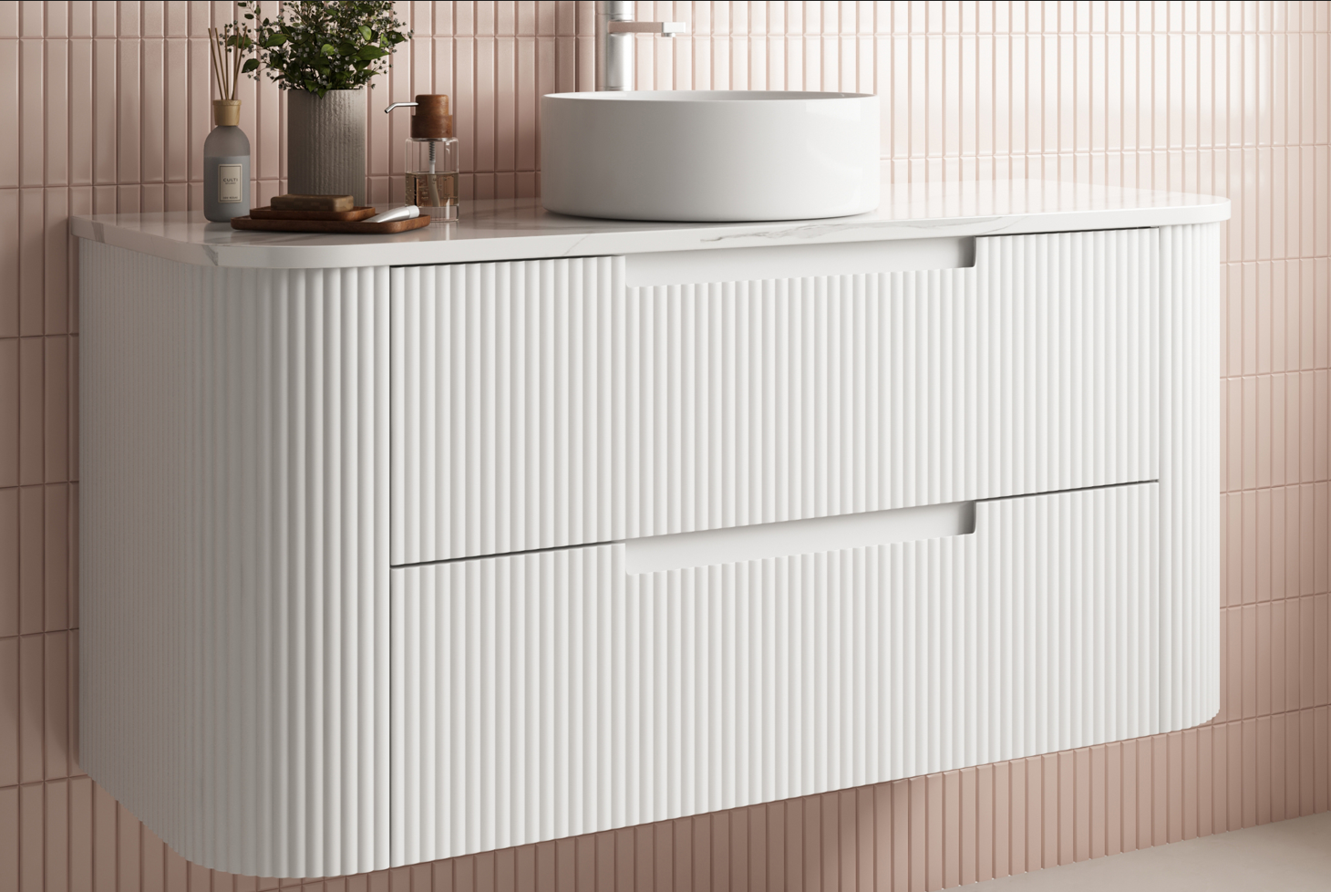
CURVA WALL HUNG
Code: CAWH46-1200
Features:
All-drawers model with curved feature ends.
Stacked drawers: Versatile and spacious
Premium-grade, durable timber plywood
Contemporary V-groove in matte white polyurethane finish
Hettich Quadro S full extension, soft close drawer runners
Minimalist L-rail design finger pull drawers
Drawer Organiser included
Premium-grade, durable timber
www.aulic.com.au
Updated in 11/2023
Aulic reserves the right to make modifications without prior notifications.

